Slide 1

Resources for Sharing our Faith
National RCIA Conference
Melbourne, 11 – 13 October, 2018
Presenter: Sharon Brewer, National Centre for Evangelisation
mission@nce.catholic.org.au | 0466 013 534

Slide 2
Categories
The Parish is the Curriculum – Always welcoming enquirers
The essential resources
The essential documentation
Programs
Ideas for young people
Other Resources - various
Resources from the National Centre for Evangelisation/Catholic Enquiry Centre
Christian Initiation Australia Network (CIAN) & TeamRCIA
Name your best resource

Slide 3
1. The Parish is the Curriculum – Always welcoming enquirers
Your parish already provides plenty of resources – even small or less active parishes have good things to offer.
We must recognise that our ‘baptism matters’
We are called to share our faith (Matthew 28:19)
Your parish (you, the priest and everyone else) is the best resource you have to enable you to share your faith, and to grow more ‘missionary disciples’ (other people who want to share their faith).
But how do we make this a reality?

Slide 4
1. The Parish is the Curriculum – Always welcoming enquirers
Good question!
It will require good leadership, it may need cultural change, hearts open to the Holy Spirit.
Culturally – we must move from the idea that ‘RCIA’ is confined to RCIA meetings and the time frame of ‘September – Easter’.
It must be all year round – we must be ready to welcome with open arms catechumen and candidates.
But how?

Slide 5
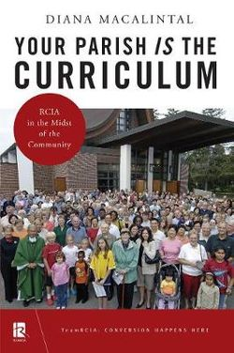
1. The Parish is the Curriculum – Always welcoming enquirers
SHARE THIS BOOK!
Diana Macalintal
Liturgical Press, Minnesota, USA
ISBN 978-0-8146-4465-2
ISBN 978-0-8146-4488-1 (e-book)
For more details: https://litpress.org/Products/4465/Your-Parish-Is-the-Curriculum
Approximate cost: $19.95 US
(Last week was $33.87 at Angus & Robertson – Australia)
Publication Date: 3 May 2018

Slide 6
1. The Parish is the Curriculum – Always welcoming enquirers
§ 118 § 1) The Parish Is the Curriculum
While this pastoral plan is concerned primarily with intentional adult faith formation programs, the success of such efforts rests very much on the quality and total fabric of parish life. This includes, for example, "the quality of the liturgies, the extent of shared decision making, the priorities in the parish budget, the degree of commitment to social justice, the quality of the other catechetical programs."⁸⁸
Our Hearts Were Burning Within Us – A Pastoral Plan for Adult Faith Formation in the United States – USCCB

Slide 7

1. The Parish is the Curriculum – Always welcoming enquirers
https://australia.alpha.org/blog/catholic

Slide 8

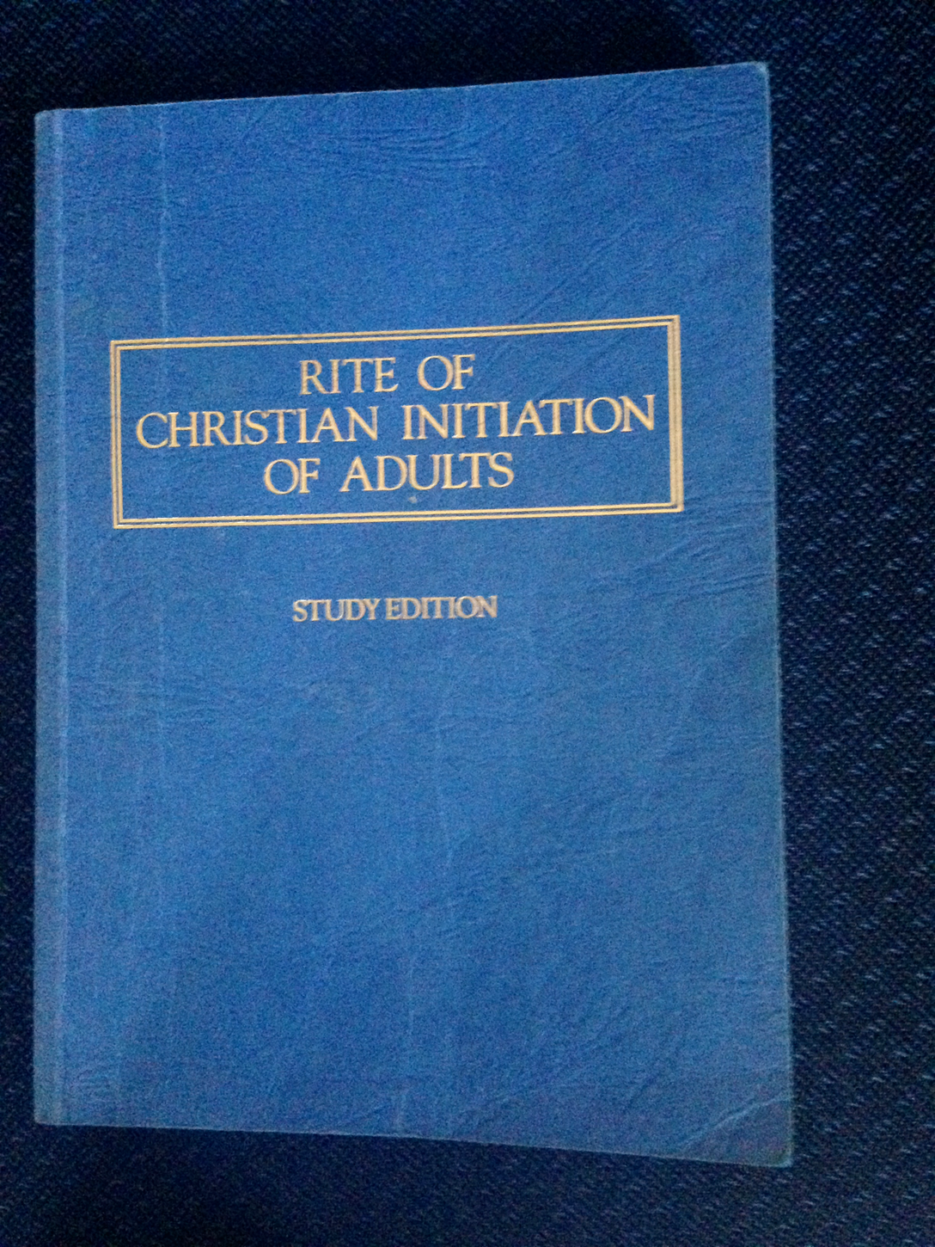
2. The Essential Resources
Pauline Books and Media - $24.95

Slide 9

2. The Essential Resources

Slide 10

2. The Essential Resources
Or get it online free: http://www.vatican.va/archive/ENG0015/_INDEX.HTM

Slide 11
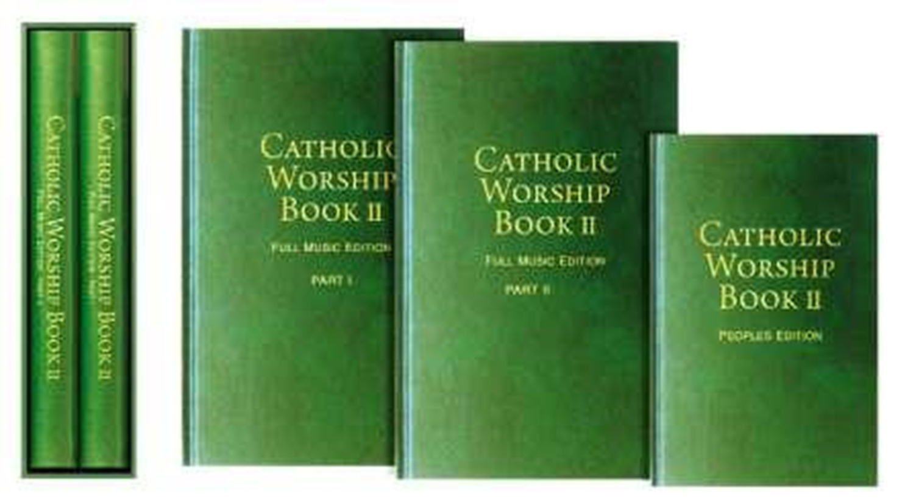
2. The Essential Resources
Suggestions for all the Stages – hymns and responses.
This link will give you an overview of what’s in this book:
http://morningstarpublishing.net.au/wp-content/uploads/CWB-CONTENTS-at-25-August-2015.pdf

Slide 12
3. The essential documentation
Invitations – where are you inviting people to learn more about their faith or ‘come and see’ about the Catholic faith (schools, libraries, community centres, and the church). What resources are you putting into your ‘parish evangelisers’ hands so that they can easily invite others to come along, or even to simply ‘have a chat’ about the faith. (1 Peter 3:15 – Always be ready ….)
Registration form that asks about baptism and marriage (including previous marriages, divorce, annulment etc) and the best way to make contact with them.
Key dates for the process. If you plan to go to the Cathedral for the Rite of Election make sure they know this – especially if it involves lengthy travel.
Info about God parents – they should know early on that this will be a requirement and they should give some thought to this.
Who should they ring if they have questions along the way.

Slide 13

4. Programs
From Evangelise Brisbane
$20.90 (Multiple copies cheaper)

Slide 14
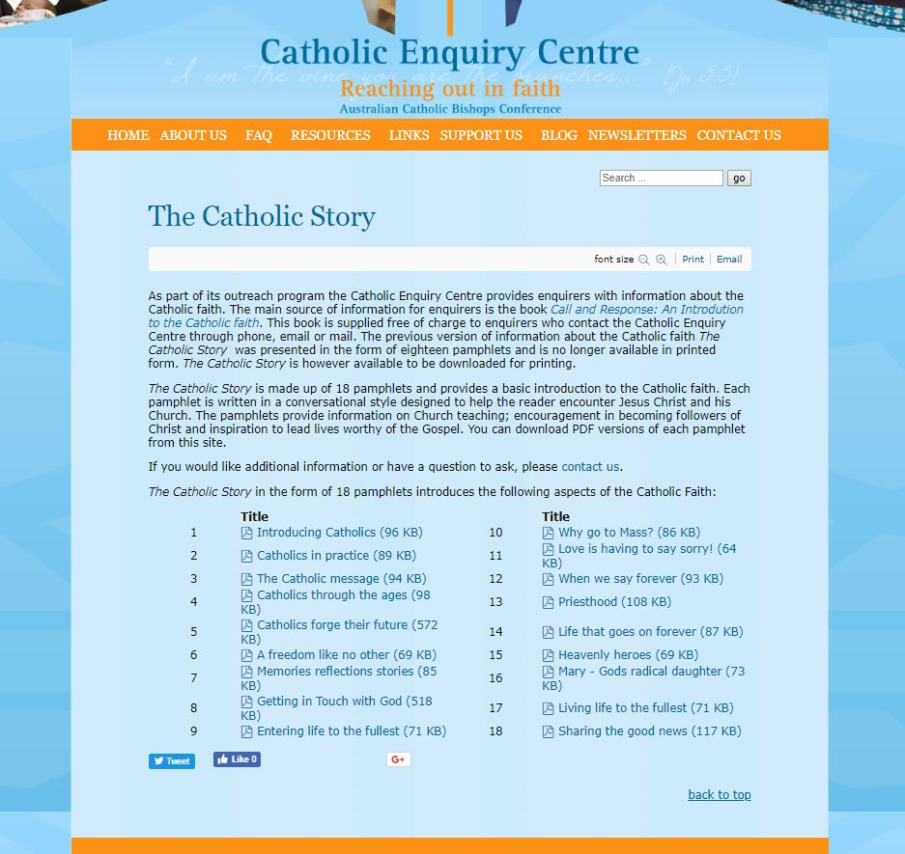

4. Programs
Audio Only – From the Catholic Enquiry Centre and available from ACBC Online Store - $22 plus P&H
Looks a little dated, but still very popular. Free downloads from Catholic Enquiry Centre – 18 weeks.

Slide 15
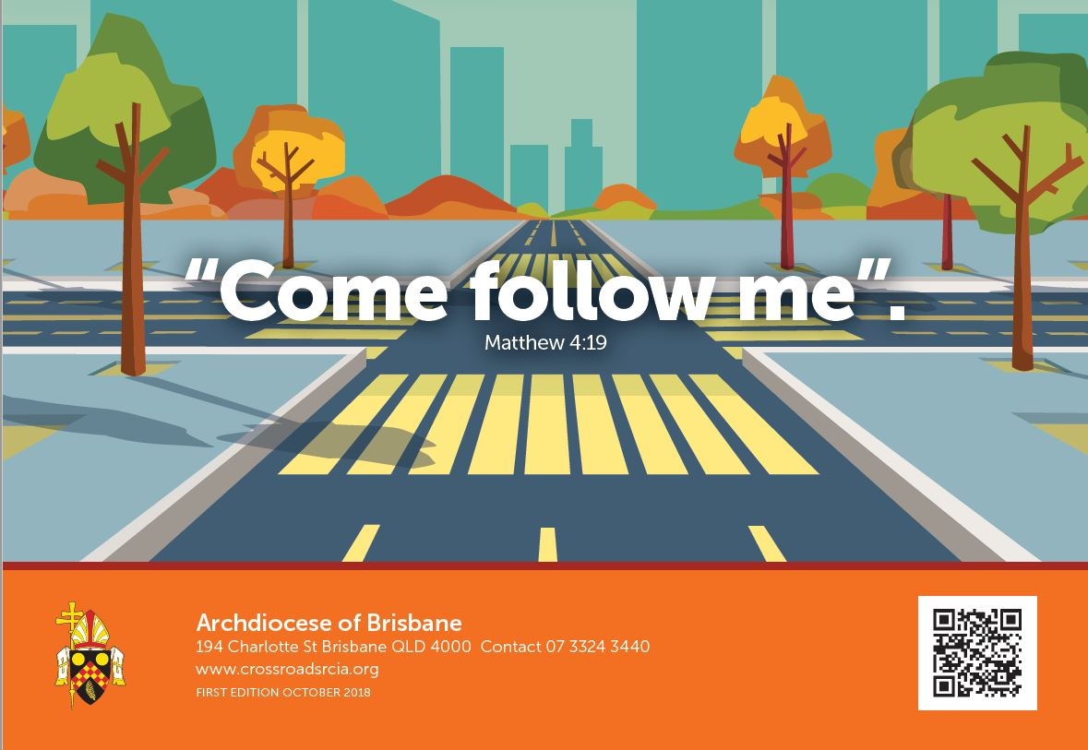
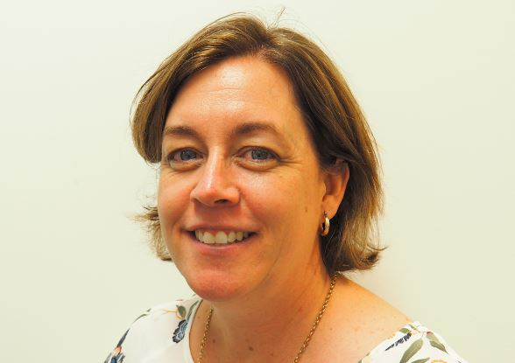
5. Ideas for young people
For 13 – 16 years
For 9 – 12 years
Lisa McKerr is here at the Conference
Notes:
Here is something from AD of Brisbane. Lisa is here, and is happy to show you the resource. It is written around the four stages of the RCIA process. It is meant to be worked on in the context of a parish based program. It will be available as a free download with an accompanying booklet for leaders.

Slide 16

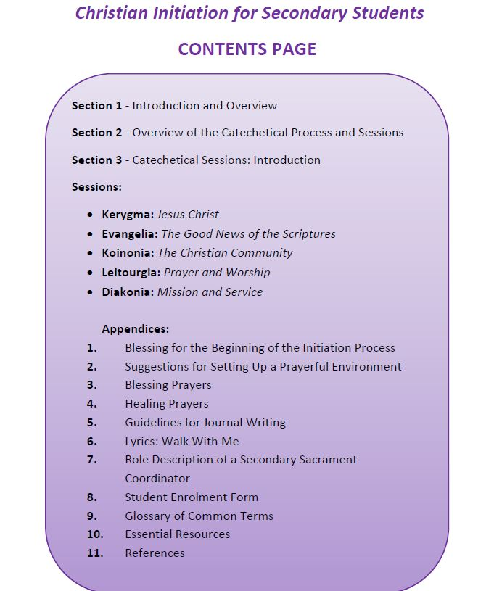
Sale Diocese, Australia
Downloadable Digit Resource $AUD50
View sample https://resources@sale.catholic.org.au
Sophy Morley 03 5622 6677
(Flyer in your conference bag)
Notes:
This is a very extensive program and has been developed over many years. It has been tested by teachers. Ring Sophy and she can calk you through some of the key issues around initiation for young people. For example, is it possible to structure this within the academic year, or use the liturgical model – which is what we usually do. Flyers in your conference pack.

Slide 17



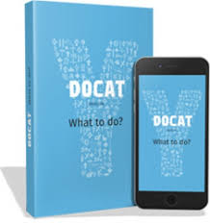
Approximate Prices from Freedom Publishing Books
Youcat - Catechism - $30
YouBible - $44.95
DoCat - $36 (DoCat App – Free - $4.49 for book)
YouCat Prayer book - $19.95

Slide 18

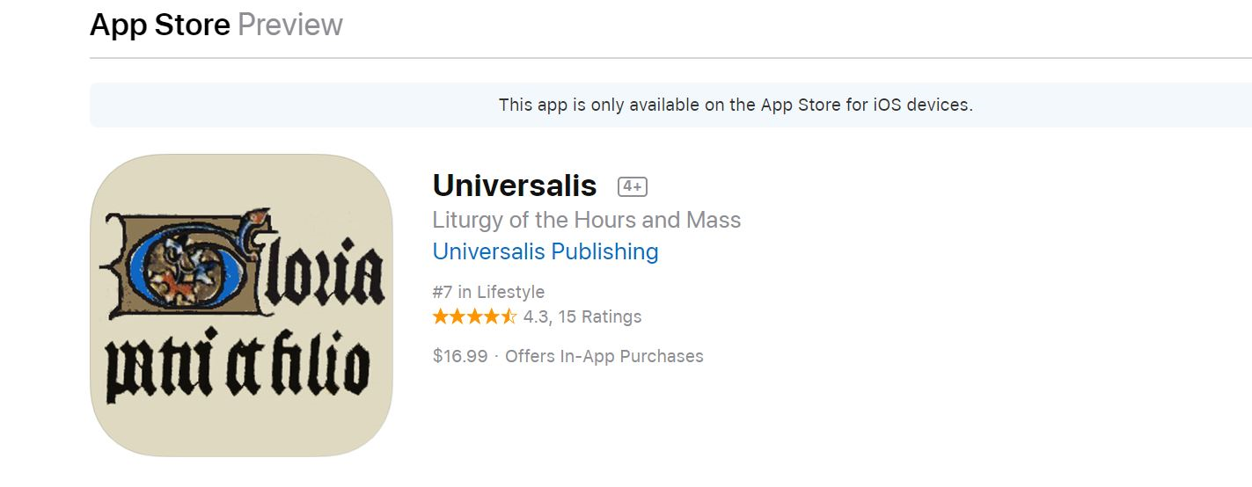
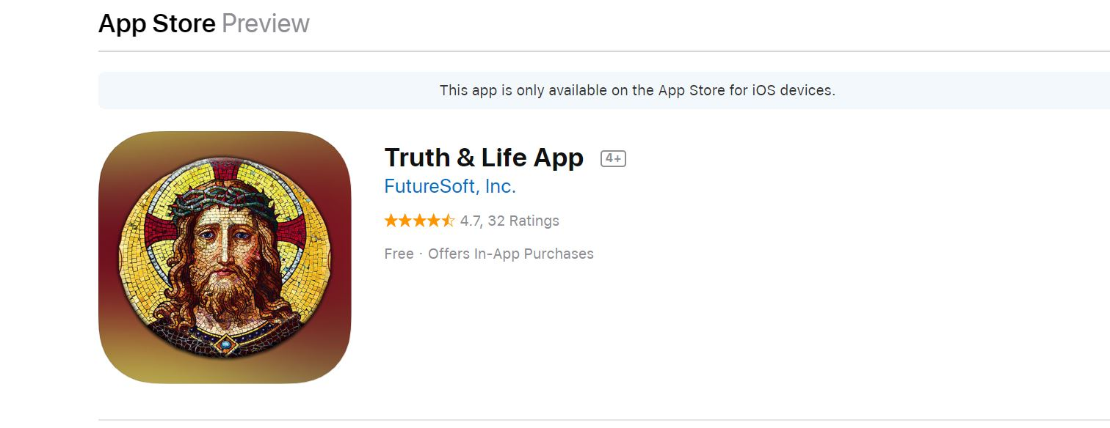
6. Other Resources - various
About $40 (Was out of stock last week at St Pauls)
Not really free if you want all the features – about $40.

Slide 19
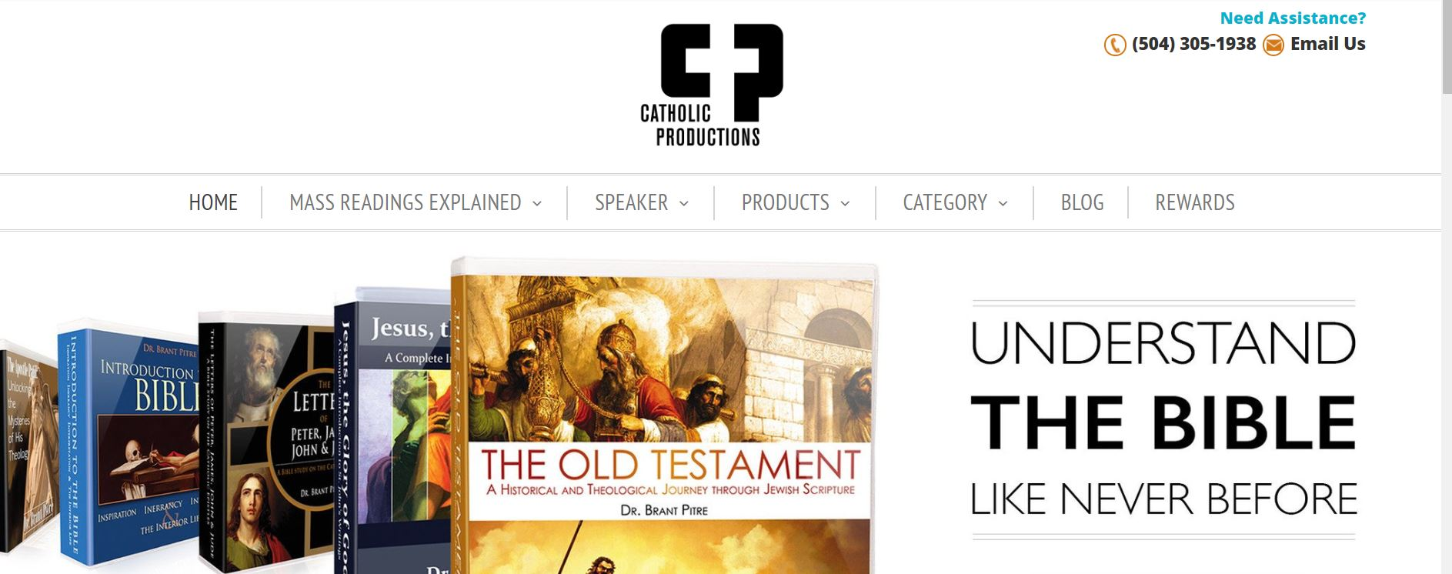
6. Other Resources - various
Dr Brant Pitre - Weekly Readings – Subscription Only - $125 US – Excellent – Here is an example: https://www.youtube.com/watch?v=pSrmS3bxOAk

Slide 20


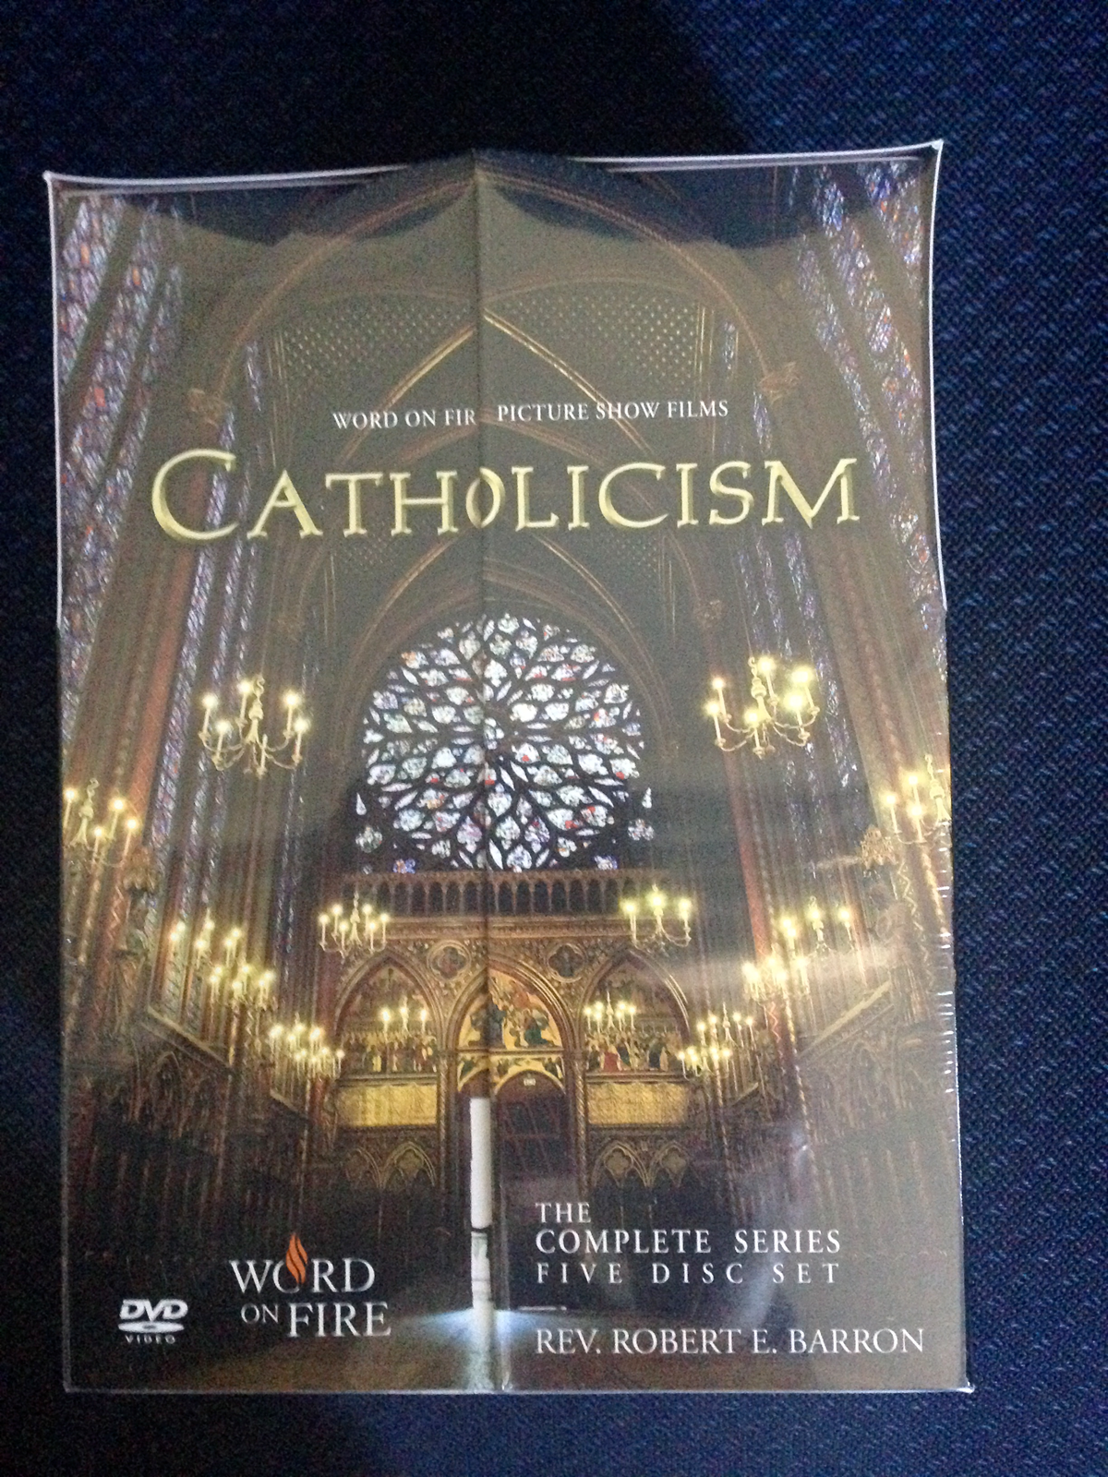

6. Other Resources - various
https://www.wordonfire.org/
https://wordonfire.institute/

Slide 21

6. Other Resources - various
https://www.catholic.com/

Slide 22
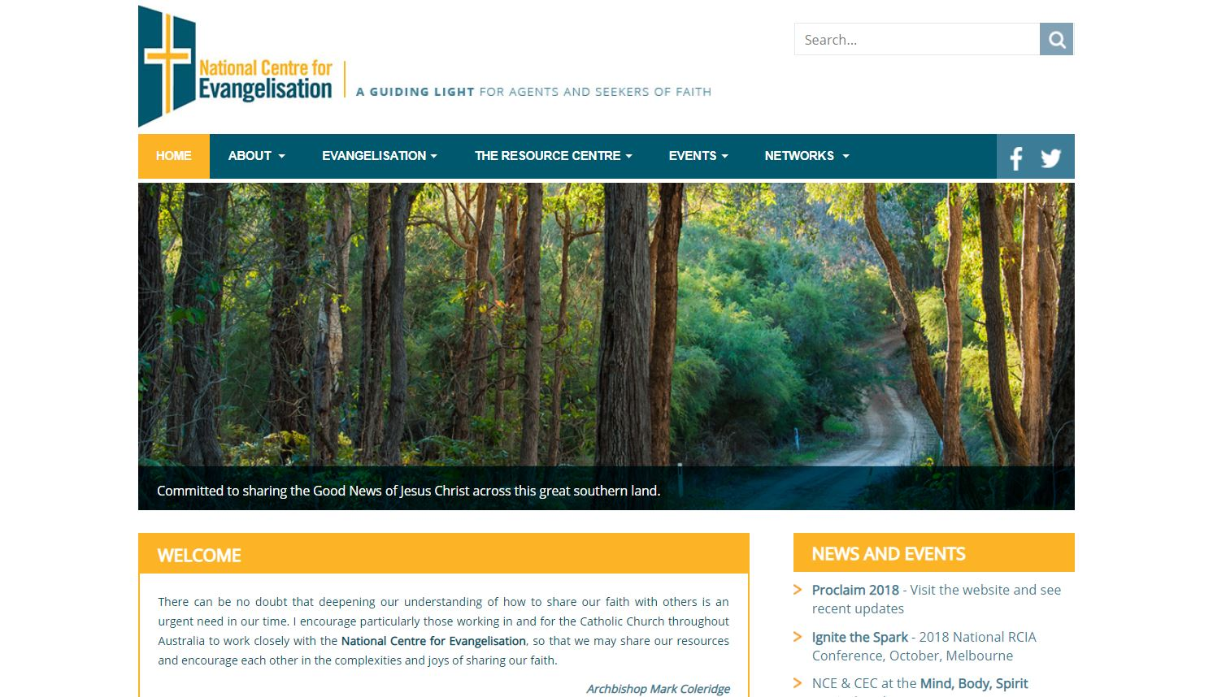
7. Resources from the National Centre for Evangelisation/Catholic Enquiry Centre
www.nce.catholic.org.au

Slide 23






7. Resources from the National Centre for Evangelisation/Catholic Enquiry Centre
$2.75 for 10 + P&H from Catholic Enquiry Centre – ACBC Online Store
250 ‘business cards’ for under $20
Free from Catholic Enquiry Centre

Slide 24
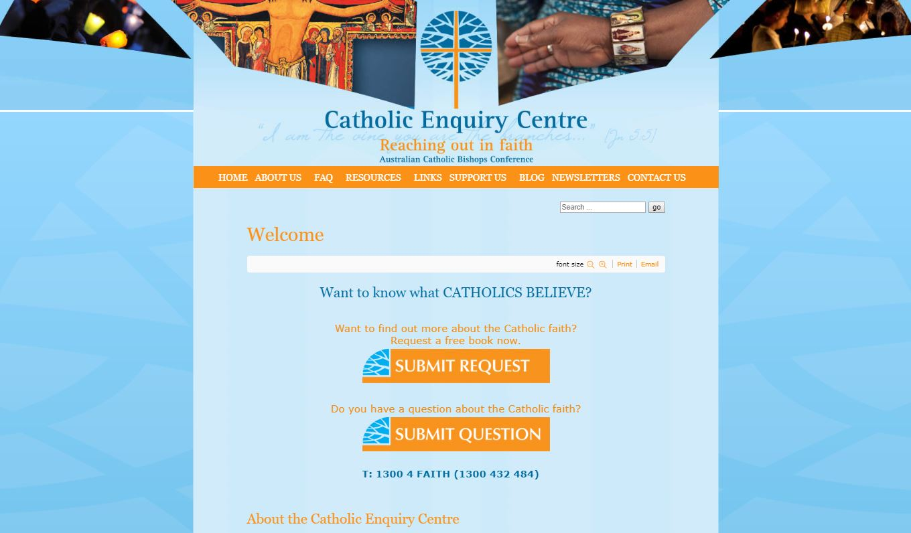
7. Resources from the National Centre for Evangelisation/Catholic Enquiry Centre
www.catholicenquiry.com

Slide 25

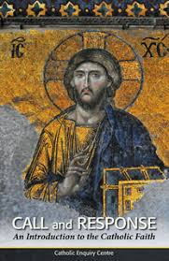
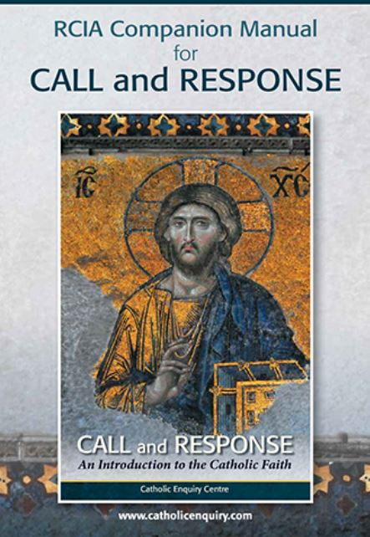
7. Resources from the National Centre for Evangelisation/Catholic Enquiry Centre
Call & Response: An Introduction to the Catholic Faith – now reduced to $8.80 plus P&H
RCIA Companion Manual: Free – ring us if you need a copy
Discovering Prayer: $3 plus P&H

Slide 26
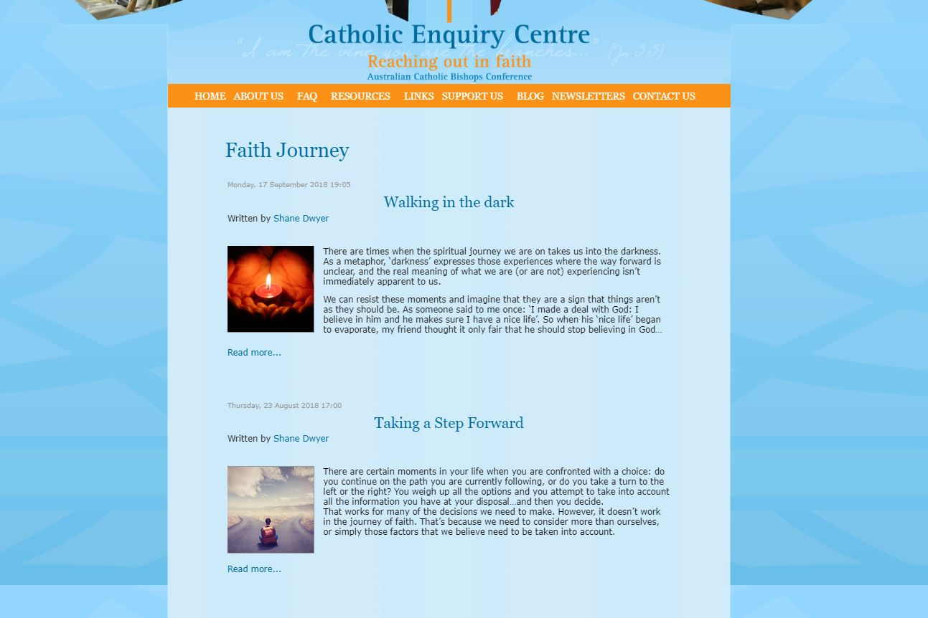
7. Resources from the National Centre for Evangelisation/Catholic Enquiry Centre
Faith Journey – monthly email from the NCE/CEC – especially useful for people coming to the faith. Electronic subscription.

Slide 27
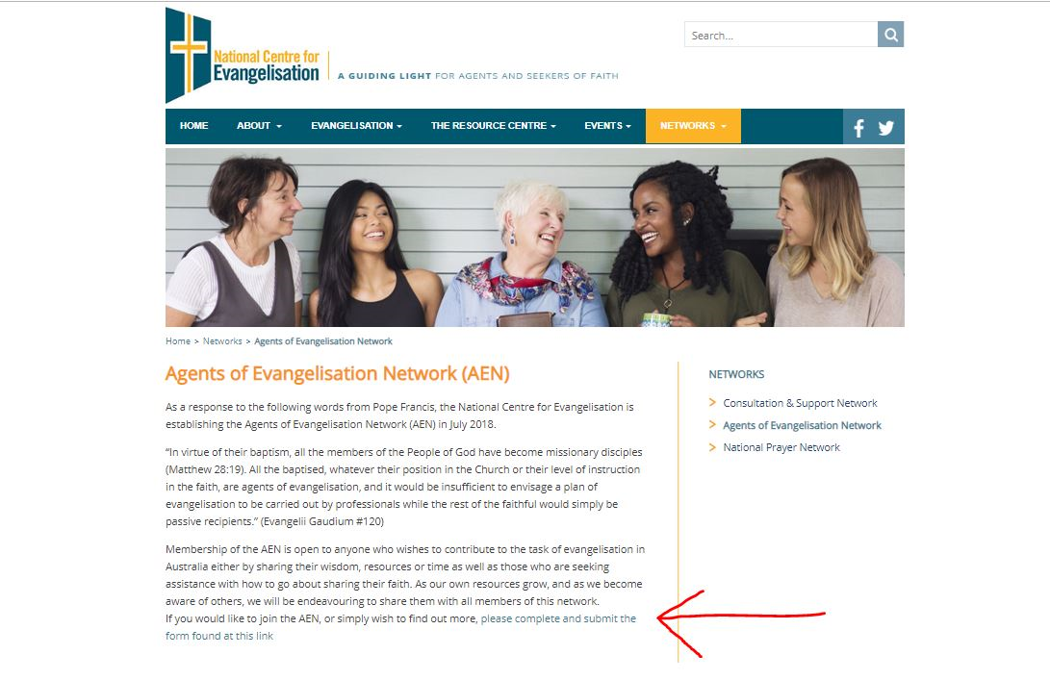
7. Resources from the National Centre for Evangelisation/Catholic Enquiry Centre
Agents of Evangelisation Network – become a member.

Slide 28

8. Christian Initiation Australia Network (CIAN) & TeamRCIA
TeamRCIA.com is a FREE online resource for Catholic parishes and dioceses that want to form Christians for life.
http://teamrcia.com/about/

Slide 29

8. Christian Initiation Australia Network (CIAN) & TeamRCIA
VISION
The Christian Initiation Australia Network CIAN is a communication and support network for Australians who share the vision of the catechumenate. The CIAN is made up of Australian pastoral ministers, liturgists, catechists, theologians and all those interested in the Catechumenate. Their purpose is to share the vision and promote the practice of the Rite of Christian Initiation of Adults (RCIA) through sharing ideas and challenges. The CIAN conduct ongoing formation at the national level. CIAN Membership is open to all Australians who have a commitment to and work with RCIA in Australia.
https://www.cianetwork.net/

Slide 30
9. Name your best resource
Does your parish or diocese have a great resource that can be shared?
What has been the most useful resource you have used for RCIA?

